Slide 1
CompTIA A+ Guide to IT Technical Support
10th Edition

Slide 2
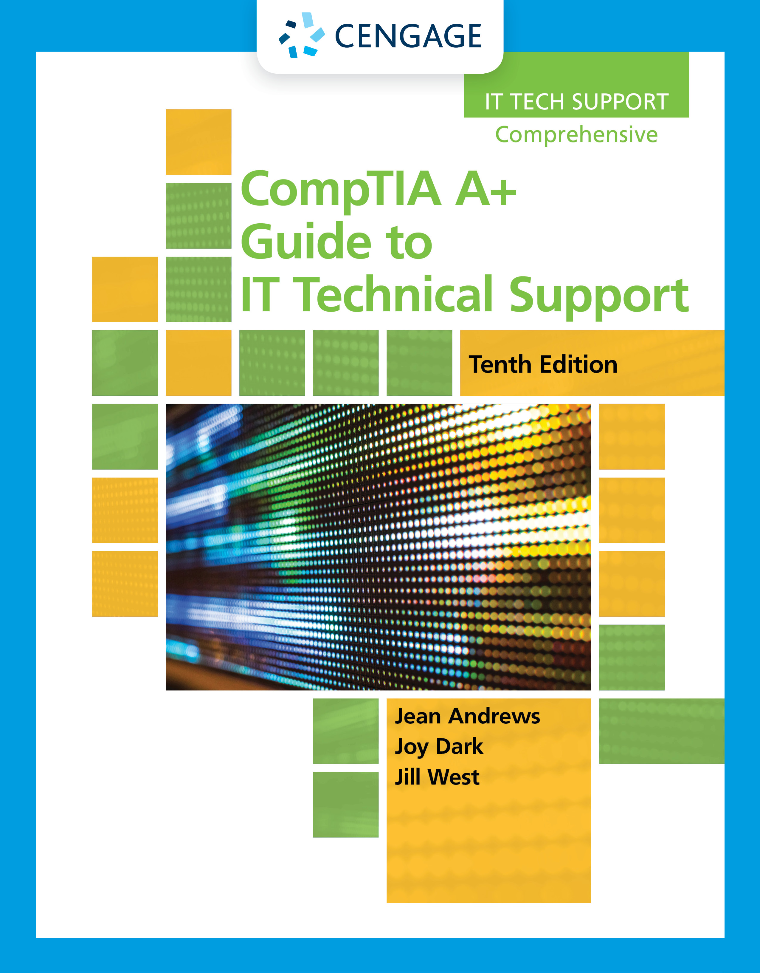
Installing Windows
Chapter 12

Slide 3
Objectives
Plan a Windows installation
Install Windows 10, Windows 8.1, and Windows 7
Configure Windows settings after the installation
Describe special concerns when installing Windows in a large enterprise

Slide 4
How to Plan a Windows Installation
Situations requiring a Windows installation
New hard drive
Existing Windows version has become corrupted
Operating System upgrade
Many decisions need to be made before the installation
Most of these decisions apply to any Windows operating system

Slide 5
Choosing the Edition, License, and Version of Windows (1 of 3)
OEM or Retail License
You can purchase a retail license or an Original Equipment Manufacturer (OEM) license
Options for both types of licenses include 32-bit and 64-bit
Key differences between OEM and retail:
OEM license is for builders and manufacturers of computers and can be installed only on a new computer
OEM allows all hardware upgrades except for an upgrade to a different model of motherboard
An OEM license costs less than a retail license
Retail licenses can be purchased from the Microsoft online store
The benefit of a retail license over OEM is that it can be transferred to a different computer and you get Microsoft direct support from Microsoft support personnel

Slide 6
Choosing the Edition, License, and Version of Windows (2 of 3)
32-Bit or 64-Bit Architecture
64-bit installation generally performs better than 32-bit
Can also support 64-bit applications, which run faster
64-bit installations of Windows require 64-bit device drivers
Must have enough RAM to support 64-bit installation

Slide 7
Choosing the Edition, License, and Version of Windows (3 of 3)
Operating System | 32-Bit Architecture | 64-Bit Architecture
Windows 10 Home Windows 8.1 | 4 GB | 128 GB
Windows 10 Pro Windows 10 Enterprise Windows 8.1 Pro Windows 8.1 Enterprise | 4 GB | 512 GB
Windows 7 Home Premium | 4 GB | 16 GB
Windows 7 Professional Windows 7 Enterprise Windows 7 Ultimate | 4 GB | 192 GB

Slide 8
Verifying That Your System Qualifies for Windows (1 of 7)
The minimum hardware requirements for Windows 10/8/7 are listed in Table 12-2 (see next slide)
Beginning with Windows 8:
Microsoft requires three technologies used by the processor (NX, PAE, and SSE2)
All processors built in the last 10 years use these technologies
MBR or GPT Partitioning System
Windows can use one of two methods to partition a hard drive:
Master boot record (MBR)
GUID Partition Table (GPT)
Windows is always installed on a volume that uses the NTFS file system
For most installations, install Windows on the only hard drive in the computer and allocate all space to one partition that Windows setup calls drive C:
Installs Windows in the C:\Windows folder

Slide 9
Verifying That Your System Qualifies for Windows (2 of 7)
Hardware | For 32-Bit Windows | For 64-Bit Windows
Processor | 1 GHz for faster; for Windows 10/8, must support NX, PAE, and SSE2
Memory (RAM) | 1 GB | 2 GB
Free hard drive space | 16 GB | 20 GB
Video device and driver | DirectX 9 device with WDDM 1.0 or higher driver

Slide 10
Verifying That Your System Qualifies for Windows (3 of 7)
BIOS/UEFI Firmware on the Motherboard
To understand if a system qualifies for Windows 8/7, it helps to understand how Windows relates to hardware by using device drivers and firmware on the motherboard
When system is turned on:
The motherboard BIOS/UEFI manages essential devices such as keyboard, monitor, and hard drive
Motherboard BIOS/UEFI is contained on a chip on the motherboard and is called a firmware chip
All modern motherboard use UEFI (Unified Extensible Firmware Interface)
UEFI is a much improved replacement for BIOS (basic input/output system)
Offers legacy support for BIOS compatibility

Slide 11
Verifying That Your System Qualifies for Windows (4 of 7)
BIOS/UEFI Firmware on the Motherboard (continued):
Motherboard UEFI/BIOS provides three functions:
System BIOS/UEFI contains instructions for running hardware devices before an OS is started
Startup BIOS/UEFI starts the computer and finds a boot device that contains an OS
Then turns the startup process over to the OS
Setup BIOS/UEFI is used to change motherboard settings
Can use it to enable or disable a device on the motherboard, change data and time, or select the order of boot devices for startup BIOS to search

Slide 12
Verifying That Your System Qualifies for Windows (5 of 7)
BIOS/UEFI Firmware on the Motherboard (continued):
Most computers today give you the option of using UEFI or legacy BIOS, which is called UEFI CSM
Consider the following:
UEFI mode is required if the hard drive is larger than 2.2 TB or is using the GPT partitioning system
UEFI and the GPT partitioning system work only with 64-bit versions of Windows 10/8/7
UEFI has a security system called Secure Boot, which helps prevent malware from hijacking a system during or before the operating system load
The only times you might select CSM mode are when you use a legacy MBR hard drive or install a 32-bit version of Windows 10/8/7

Slide 13
Verifying That Your System Qualifies for Windows (6 of 7)
Application and Hardware Compatibility
Device drivers are small programs stored on the hard drive that tell the computer how to communicate with a specific hardware device
32-bit OS requires 32-bit drivers and 64-bit OS requires 64-bit drivers
Device drivers can be downloaded from the manufacturer’s website or found on installation DVDs
When installing, be sure to have correct Windows device drivers for all critical devices
Not sure if devices will work with Windows 10/8/7?
Set up a dual boot (also called multiboot)
After installation, test your software or hardware
If they work under the new OS, you can delete the old one

Slide 14
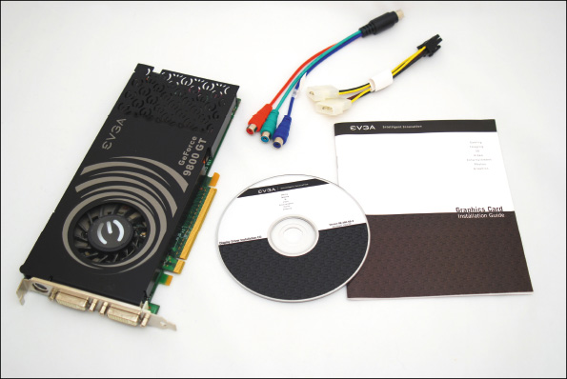
Verifying That Your System Qualifies for Windows (7 of 7)
Figure 12-7 A device such as this video card comes packaged with its device drivers stored on a CD

Slide 15
Choosing the Type of Installation: In-Place Upgrade, Clean Install, or Dual Boot (1 of 2)
If a hard drive is new, a clean install must be installed
If an OS is already installed, you have three options
Clean install: overwrites the existing OS and applications
In the Windows setup program, a clean install is called a custom installation
Advantage: get a fresh start
In-place upgrade: a Windows installation that is launched from the Windows desktop and keeps user settings and installed applications from the old OS
Requires qualifying OSs called upgrade paths
Multiboot: you can install Windows in a second partition and create a dual-boot situation
Need at least two partitions or a second hard drive

Slide 16
Choosing the Type of Installation: In-Place Upgrade, Clean Install, or Dual Boot (2 of 2)
Other tips to keep in mind:
A 64-bit version of Windows can only be upgraded to a 64-bit OS
A 32-bit OS can only be upgraded to a 32-bit OS
If you want to install a 64-bit version of Windows over a 32-bit OS, a clean install must be performed

Slide 17
Understanding the Choices You’ll Make During the Installation
The Size of the Windows Partition
You can decide not to use all the available space on the drive for the Windows partition
Reasons not to use all available space:
You plan to install more than one OS on the hard drive, creating a dual-boot system
Some people prefer to use more than one partition or volume to organize data on their hard drives
Network Configuration
To join a domain, you’ll need the network ID and password assigned to you by the network administrator
To join a homegroup, you’ll need the password to the homegroup
To use a workgroup, you configure each computer to share its folders and files to specific people
You might need to know how the IP address is assigned (dynamically or statically)

Slide 18
Final Checklist Before Beginning the Installation (1 of 6)
Questions to Answer | Further Information
Does the computer meet the minimum or recommended hardware requirement? | CPU: RAM: Hard drive partition size: Free space on the partition:
Do you have the Windows device drivers for your hardware devices and application setup CDs? | List hardware and software that need to be upgraded:
Do you have the product key available? (It might not be required if you are reinstalling Windows 10.) | Product key:
How will users be recognized on the network? | Homegroup password (for Windows 8/7): Domain name: Computer name: Network ID: Network password:

Slide 19
Final Checklist Before Beginning the Installation (2 of 6)
Questions to Answer | Further Information
How will the computer be recognized on the network? | Static or dynamic IP addressing: IP address (for static addressing):
Will you do an upgrade or a clean install? | Current operating system: Does the old OS qualify for an upgrade?
For a clean install, will you set up a dual boot? | List reasons for a dual boot: Size of the second partition: Free space on the second partition:
Have you backed up important data on your hard drive? | Location of backup:

Slide 20
Final Checklist Before Beginning the Installation (3 of 6)
General tips for installing Windows:
Verify all application software DVDs and device drivers are available
Back up all important data
If not reformatting the drive, run antivirus software to ensure the drive is free from malware
Use BIOS/UEFI setup to verify the boot sequence needed for installation
In BIOS/UEFI setups, disable any virus protection setting that might prevent the boot area of the drive from being altered
Set BIOS/UEFI to use UEFI mode or UEFI CSM mode
For laptops, use AC adapter so you don’t run out of battery

Slide 21
Final Checklist Before Beginning the Installation (4 of 6)
Verify That You Have the Windows 10 Product Key
Typically, you’ll purchase Windows 10 online and product key will be emailed to the Microsoft account used to make the purchase
If purchased on a USB flash drive, look for the product key printed on the cover of the flash drive case, on a card inside the case, or affixed to the back of the Windows documentation booklet
The product key might not be required to reinstall Windows
For a laptop, all-in-one, or other brand-name computer, the computer manufacturer might have stored the Windows product key on motherboard firmware

Slide 22
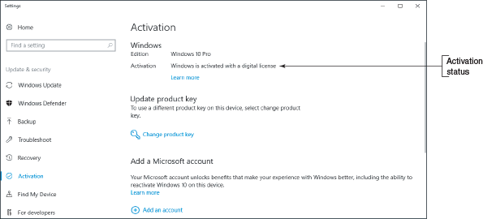
Final Checklist Before Beginning the Installation (5 of 6)
Figure 12-8 This installation of Windows was activated using a digital license stored on Microsoft activation servers

Slide 23
Final Checklist Before Beginning the Installation (6 of 6)
Useful information about an ISO file:
An ISO file is an image of an optical disc, including its file system and all its files and folders
Also called an ISO image or disc image
To see the contents of an ISO file, open File Explorer or Windows Explorer, right-click the file, and click Mount
The ISO file is assigned a drive letter
If you have an optical drive that can write to DVDs, you can burn a DVD from an ISO file
Later in the chapter, you learn how to mount an ISO file to virtual DVD drive in a virtual machine and use it to install Windows in the VM

Slide 24
Installing Windows 10, Windows 8.1, and Windows 7
Topics covered
Learn how to install Windows as an:
In-place upgrade
Clean install
Dual boot
How to handle using a Windows upgrade product key to install Windows on a new hard drive
Make sure you document what you did during the installation
Documentation might be helpful for future maintenance and troubleshooting

Slide 25
Windows 10 In-Place Upgrade (1 of 5)
Steps to upgrade from Windows 8.1 to Windows 10
1. Sign in to Windows using an administrator account
2. Before you start the upgrade, do the following:
Scan the system for malware
Uninstall any applications or device drivers you don’t intend to use in the new installation
Make sure your backups are up to date
3. Insert Windows 10 setup DVD or flash drive or mount the setup ISO file
4. Open File Explorer and double click setup.exe
5. At the next window, enter the product key and Windows verifies the key is a valid key
If connected to Internet, setup will activate Windows

Slide 26
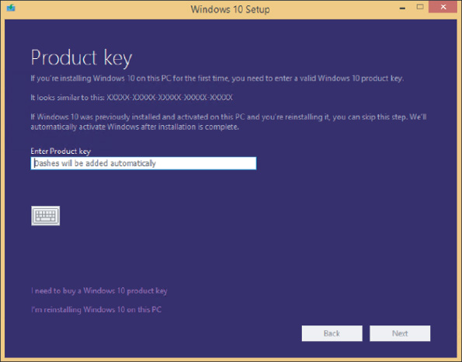
Windows 10 In-Place Upgrade (2 of 5)
Figure 12-13 The product key is verified as valid during the setup process

Slide 27
Windows 10 In-Place Upgrade (3 of 5)
Steps to upgrade from Windows 8.1 to Windows 10 (continued)
6. Accept the license terms
7. Wait for updates to download, then verify that Keep personal files and apps is selected
8. On the Choose what to keep screen, decide what you want to do with Windows settings:
First two options perform upgrades to Windows 10
The Nothing option performs a clean install of Windows 10
9. On the Ready to install window, verify the choices listed and click Install
10. During installation, setup may restart system several times
When the Welcome to Windows 10! screen appears, click Next

Slide 28
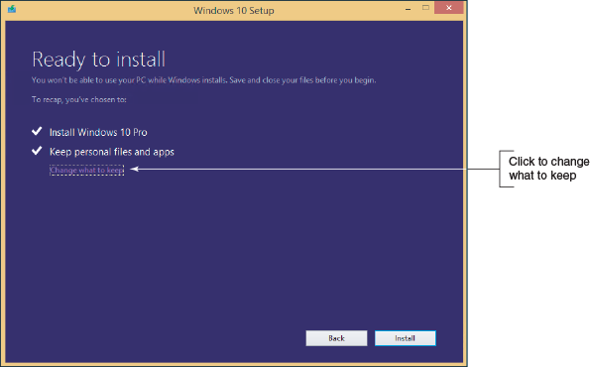
Windows 10 In-Place Upgrade (4 of 5)
Figure 12-14 Windows is ready to install as an upgrade, but you can still change what to keep

Slide 29
Windows 10 In-Place Upgrade (5 of 5)
Steps to upgrade from Windows 8.1 to Windows 10 (continued)
11. On the Choose privacy settings for your device screen, select the privacy settings for location, speech recognition, diagnostics, tailored experiences with diagnostic data, and relevant ads, and then click Accept
12. On the Meet Cortana screen, you can decide to give Microsoft permission to use your information to personalize your experience with Cortana
13. The New apps for the new Windows screen appears
Review the new apps and click Next
14. Settings are applied and the Windows 10 sign-on screen appears

Slide 30
Windows 10 Clean Install (1 of 4)
If you have a Windows 8/7 installation that qualifies for a Windows 10 upgrade and you need to do a clean install, follow these steps:
1. Start the installation from the Windows desktop
2. Follow the previous steps for an in-place upgrade to enter the product key, accept license terms, and download updates
3. When you get to the Ready to install window, click Change what to keep
4. On the Choose what to keep window, click Nothing and click Next

Slide 31
Windows 10 Clean Install (2 of 4)
Use the following steps to perform a clean install on a newly installed hard drive, on a new computer you’re building, or on a computer that has a corrupted Windows installation:
1. Boot from Windows setup DVD or USB flash drive and choose Install now
2. Enter your product key, click Next
3. Accept the license agreement, click Next
Click Custom: Install Windows only (advanced)
4. On the Where do you want to install Windows? screen, select the drive and volume where you want to install Windows
If you want to use only a portion of the volume, click New and enter the size of the volume
Click Next to continue
5. Installation begins, system might restart several times
Choose your region and click Yes

Slide 32
Windows 10 Clean Install (3 of 4)
Steps to perform a clean install on a newly installed hard drive, on a new computer you’re building, or on a computer that has a corrupted Windows installation (continued):
6. On the next screen, choose the right keyboard layout and click Yes
You will be given the option to add a second keyboard layout, click Skip
7. The setup program detects if your computer is connected to the Internet, checks for updates, and moves on to the next screen
The next steps assume you have an Internet connection, if not, click Ethernet to make the connection
8. On the How would you like to set up? screen, you can choose to set up the computer on a school or business network and have limited control
Select Set up for personal use and click Next
9. On the Sign in with Microsoft screen, you can choose to use an existing Microsoft account, create a new one, or create an offline account

Slide 33
Windows 10 Clean Install (4 of 4)
Steps to perform a clean install on a newly installed hard drive, on a new computer you’re building, or on a computer that has a corrupted Windows installation (continued):
10. On the Sign in with Microsoft instead? screen, Microsoft encourages you to use a Microsoft account instead of offline account, click No
11. Enter the name for the user of the local account, click Next, enter a password for the offline account, click Next, confirm password, click Next, create a password hint, click Next
12. On the Make Cortana your personal assistant? screen, click Yes to accept Cortana
13. Select the devices privacy settings and then click Accept
14. Installation continues, settings are applied, and the Windows desktop appears

Slide 34
Multiboot Installations (1 of 2)
In a multiboot, each OS must have its own hard drive partition with enough free space to hold OS with room for applications, data, and OS working space
Steps to set up a dual boot system:
1: Install Windows 8.1, leaving some unallocated space for Windows 10 partition
2: To install Windows 10, make sure you have a second partition with enough unallocated space
3: Start the Windows 10 installation by booting from the Windows 10 setup DVD or USB flash drive
Step 4: Select the partition or unallocated space to hold the installation

Slide 35
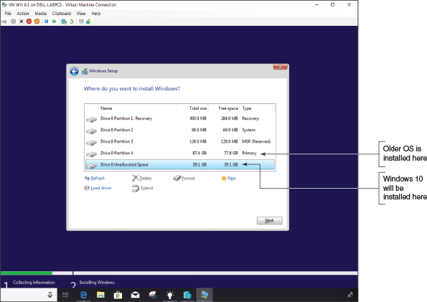
Multiboot Installations (2 of 2)
Figure 12-22 Select unallocated space or a partition other than the one used by the first OS installation

Slide 36
Solving Problems with Installations (1 of 2)
Use an Upgrade Product Key on a New Hard Drive
Sometimes you might need to use the upgrade key to install Windows when replacing a hard drive
The first free releases of Windows 10 can be activated using Windows 8.1 , 8, or 7 product keys
For Version 1607 or later, reinstall Windows 10 by logging in with your Microsoft account and activate Windows using the Activation troubleshooter in the Settings app
In a situation where a Windows 7 system was upgraded to Windows 8.0 and then updated to Windows 8.1:
1. Reinstall Windows 7
2. Reinstall Windows 8.0 using the upgrade product key and activate Windows 8
3. Download and install Windows 8.1 upgrade

Slide 37
Solving Problems with Installations (2 of 2)
Repair a Damaged Hard Drive
Besides disport, you can also use the format command
Two types of formats:
Quick format, which creates an empty root directory for a volume
Full format, which creates an empty root directory, checks each sector on the volume for errors, and marks bad sectors so they will not be used by the file system
If you suspect the hard drive is damaged and Windows will not start:
Launch the command prompt windows from Windows setup media and perform a full format

Slide 38
What To Do After a Windows Installation
After installing Windows, do the following:
Verify network access
Activate Windows
Install Windows updates and verify update settings and malware settings
Install hardware
Set up user accounts and transfer or restore user data and preferences from backups to the new system
Install applications
Turn Windows features on or off
For laptops, use Control Panel to configure power-management settings

Slide 39
Verifying Network Access
1. To make a wired connection, plug in the network cable and let Windows do the rest
To create a wireless connection, click the network icon in the taskbar and select the wireless network (may need to enter a password to the Wi-Fi network)
2. To verify you have access to the local network:
Open File Explorer or Windows Explorer and verify that you can see other computers on the network
3. To verify Internet access:
Open Internet Explorer and try to navigate to websites
If a problem arises, consider that the problem might be:
You need to install the drivers for the motherboard/onboard network port
IP address, wireless network, or network security settings are wrong

Slide 40
Activating Windows (1 of 2)
Microsoft requires product activation
Ensures a valid Windows license has been purchased
If you entered a product key during the installation:
Windows is already activated
To view activation status, open the Settings app, select the Update & security group, and then select Activation
Problems With Activation
Replacing a failed hard drive
Upgrading the motherboard
Replacing a failed motherboard
Upgrading from Windows 8 Home to Windows 10 Pro
Reinstalling Windows 10 Pro

Slide 41
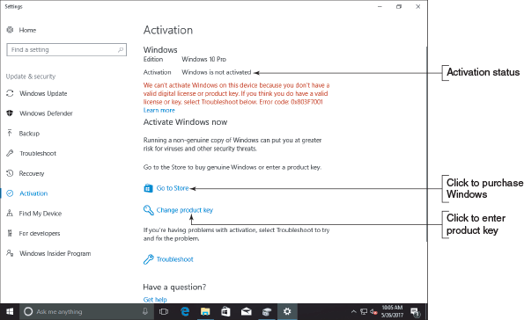
Activating Windows (2 of 2)
Figure 12-28 View the activation status using the Settings app

Slide 42
Installing Windows Updates (1 of 3)
Windows 10 updates automatically by default
To apply any pending Windows 10 updates, open the Settings app and click the Update & security group
In the Windows update window, view the update status and install any available updates
You might click Restart now to finish installing updates, click Install now to install available updates, or click Check for updates if no updates are available
Tools to manage updates settings include the Settings app, Group Policy, and registry editor
Options for managing updates from the Settings app:
View or uninstall an update
Schedule restarts and active hours
Update other Microsoft products and Windows features
Defer or pause updates

Slide 43
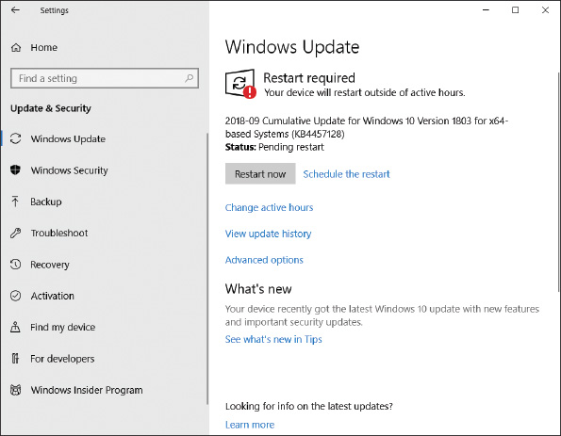
Installing Windows Updates (2 of 3)
Figure 12-31 View and manage Windows 10 updates

Slide 44
Installing Windows Updates (3 of 3)
Malware Protection
Windows includes its own preinstalled, anti-malware software called Windows Defender Antivirus in Windows 10 (Windows Defender in Windows 8/7)
To verify the utility is running in Windows 10:
Open Control Panel, click Security and Maintenance, and expand the Security group
To verify protection in Windows 8:
Launch Windows Defender from the Start screen or menu
On the Settings tab, verify that Real-time protection is turned on

Slide 45
Installing Hardware (1 of 4)
Devices that were not automatically installed during the installation must be installed
As you install each device, reboot and verify operation before moving on to next device
You may need to do the following:
Install the drivers for the motherboard
Install the drivers that came with the video card so you can use all the features the card offers
Install printers
For other hardware devices, read and follow manufacturer directions for the installation

Slide 46
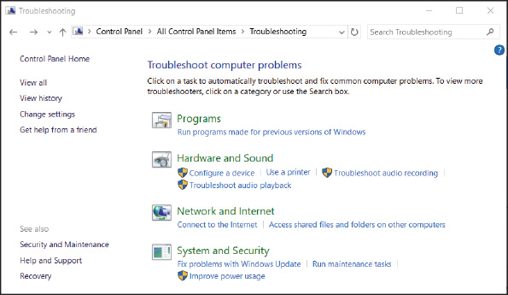
Installing Hardware (2 of 4)
Figure 12-36 Use the Troubleshooting app in Control Panel to resolve hardware installation problems

Slide 47
Installing Hardware (3 of 4)
Use Device Manager
Device Manager: the primary Windows tool for managing hardware
You can disable or enable a device, update its drivers, uninstall a device, and undo a driver update
To access Device Manager, use one of these methods:
For Windows 10/8, right-click Start and select Device Manager
Open the System window and click Device Manager
Enter the devmgmt.msc command in the Windows 10/7 search box or the Windows 8 Run box
Ways to use Device Manager to solve problems:
Uninstall and reinstall the device
Look for error messages offered by Device Manager
Update or roll back the drivers

Slide 48
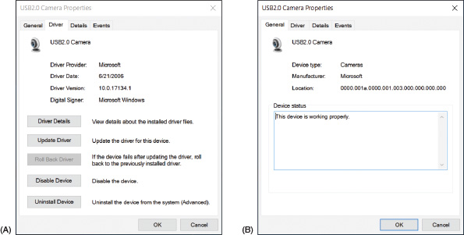
Installing Hardware (4 of 4)
Figure 12-38 (A) Use the device’s Properties box to uninstall a device and (B) solve problems with device drivers

Slide 49
Setting Up User Accounts (1 of 7)
Types of user account and the privileges associated with them:
The scope of the account (Windows offers three types of user accounts):
Local account – created on the local computer and is recognized only on the local computer
Network ID – Professional and business editions allow a user to sign in to Windows with a network ID and password created and maintained on a Windows domain in Active Directory or Azure Active Directory
Microsoft account – for Windows 10/8; an email address initially set up at the Microsoft website, live.com
Gives you access to several types of online accounts
You can associate or link a Microsoft account to a local account or network ID
Privileges for the account:
Administrator account or standard account

Slide 50
Setting Up User Accounts (2 of 7)
Use a Microsoft Account with Windows 10/8
You can associate your local account with your Microsoft account or set up Windows to sign in with your Microsoft account in order to get easy access to Microsoft resources in the cloud
Anyone with administrative rights to the computer can access your Microsoft private settings, apps, online account, and OneDrive stored on the local computer
For Windows 10 – open the Settings app, click Users and then click Sign in with a Microsoft account instead (follow on-screen directions)
For Windows 8 – open the charms bar, select the Settings charm, select Change PC settings, click Accounts, select Your account and click Connect to a Microsoft account (follow on-screen directions)

Slide 51
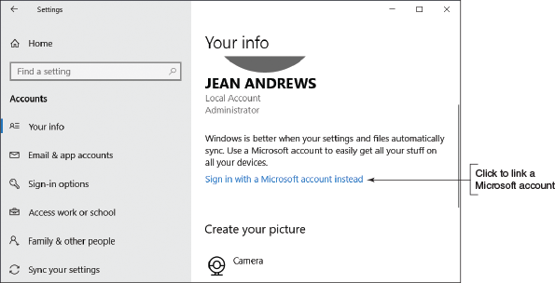
Setting Up User Accounts (3 of 7)
Figure 12-41 Associate a local account with a Microsoft account

Slide 52
Setting Up User Accounts (4 of 7)
As you consider the differences among accounts, consider where the account is authenticated:
A local account is authenticated on the local computer and gives access to the local computer
A network ID is authenticated by a computer on the network, which gives access to the local computer and other resources on the Windows domain
A Microsoft account is authenticated on the live.com website, which gives access to the local computer and online resources
A Microsoft account can be a standard account or an administrator account
It can be associated with a network ID so that you can sign in with the Microsoft account and be authenticated to the Windows network as well as to live.com

Slide 53
Setting Up User Accounts (5 of 7)
User Account Control Dialog Box
Purposes of the User Account Control (UAC) dialog box:
To prevent malicious background tasks from gaining administrative privileges when the administrator is signed in
To make it easier for an administrator to sign in using a less powerful user account for normal desktop activities, but still be able to perform administrative tasks while signed in as a regular user
You can control how the UAC works
In Control Panel, click User Accounts and click Change User Account Control settings (see Figure 12-43)

Slide 54
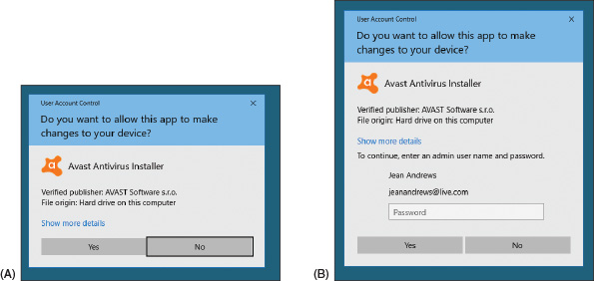
Setting Up User Accounts (6 of 7)
Figure 12-42 (A) The User Account Control box of an administrator does not require an administrative password; (B) the UAC box of a standard user requires an administrative password

Slide 55
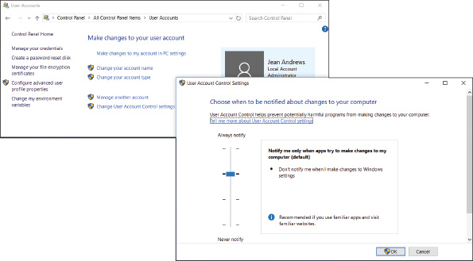
Setting Up User Accounts (7 of 7)
Figure 12-43 Windows provides options to control the UAC box

Slide 56
Installing Applications (1 of 2)
Before installing an application, consider:
System requirements
Compatibility with the OS
Impact to network performance
Impact to device security
Local user permissions
Applications can be installed from:
CD, DVD, or USB flash drive, from a downloaded application file, directly from the web, from the Windows 10/8 Windows Store, or from a folder shared by another computer on the network
Use File Explorer or Windows Explorer to locate and double-click the setup program file
When installing from the web, click the link on the website and follow on-screen directions

Slide 57
Installing Applications (2 of 2)
Uninstall Applications
For Windows 10/8/7, open Control Panel and click Programs and Features
For Windows 10, right click Start or press Win+X, click Apps and Features
For Windows 8, right-click Start or press Win+X, click Programs and Features
Using either the Programs and Features window or the Apps and Features window:
Select an app and click Uninstall
You can also uninstall a Windows 10/8 app that provides a tile on the Start menu or Start screen:
Right-click the app tile and then click Uninstall

Slide 58
Turning Windows Features On or Off (1 of 2)
Save on system resources by turning off Windows features you will not use
In the left pane of the Programs and Features window, click Turn Windows features on or off
Check or uncheck the features you want or don’t want and then click OK
Sometimes a restart is necessary
Make one last check that all is well and document what you did

Slide 59
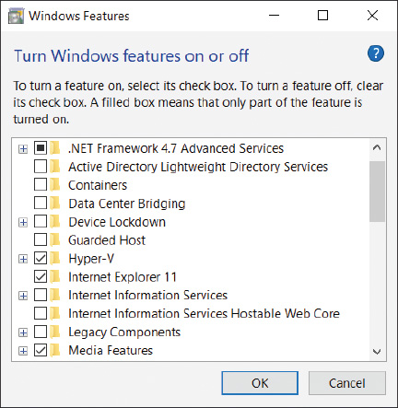
Turning Windows Features On or Off (2 of 2)
Figure 12-45 Turn Windows features on or off

Slide 60
Installation in a Virtual Machine (1 of 3)
A virtual computer or virtual machine (VM) is software that simulates the hardware of a physical computer
You can install and run multiple OSs at the same time on a single computer (called the host machine)
Software used to manage VMs installed on a workstation is called a hypervisor
Popular hypervisors for Windows:
Client Hyper-V and Virtual PC by Microsoft, VirtualBox by Oracle, and VMware Player by VMware
Client Hyper-V is embedded in Windows 10/8 Pro or Enterprise
VM programs require a lot of memory and might slow down your system

Slide 61
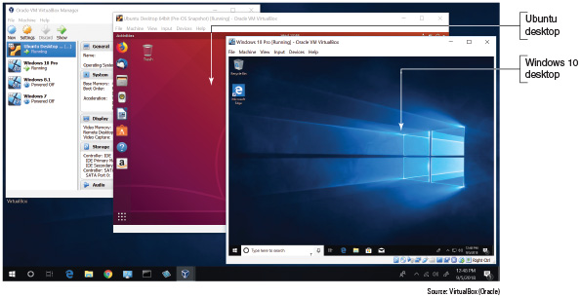
Installation in a Virtual Machine (2 of 3)
Figure 12-46 Two virtual machines running under VirtualBox

Slide 62
Installation in a Virtual Machine (3 of 3)
Install Windows in a Client Hyper-V VM
Client Hyper-V is part of 64-bit Windows 10 Pro
Your processor and motherboard must support hardware-assisted virtualization (HAV)
Generation 1 VMs allow either a 32-bit or 64-bit installation of an OS in a VM
Generation 2 VMs require a 64-bit guest OS
Hyper-V can connect a VM to the local network
Client Hyper-V supports dynamically expanding virtual hard drives and dynamically allocated memory

Slide 63
Special Concerns When Working in a Large Enterprise
Working as an IT support technician in a large corporate environment is different from working in a small company or with individuals
This part of the chapter introduces you to how Windows is installed on computer in an enterprise
Called deployment strategies
Beginning with Windows 10, Microsoft expanded the methods it offers to deploy Windows in an enterprise
These methods are listed in Table 12-6

Slide 64
Methods to Deploy a Standard Image (1 of 2)
A standard image contains the entire Windows volume in a single Windows Imaging (WIM) file
Has a .wim file extension
Installing Windows on a computer via a standard image is called image deployment:
A standard image is hardware independent
A standard image is created in a process called drive imaging
Deploying a standard image always results in a clean install rather than an upgrade

Slide 65
Methods to Deploy a Standard Image (2 of 2)
Image deployment can be started using one of these methods:
Local installation
Can use a bootable flash drive or DVD that contains the image
Windows Preinstallation Environment (Windows PE) is launched; this is a minimum OS used to start the installation
Network installation
Boot to the network and deploy the image from a server
Push automation
A technician does not start the image deployment
The entire remote network installation is automated and no user intervention is required
An unattended installation uses an answer file where responses are stored

Slide 66
Using USMT Software
The User State Migration Tool (USMT) can be used when deploying Windows in a Windows domain
Copies user files and settings from one computer to another
What to expect when using the following USMT commands:
scanstate: copies user settings and files from the source computer to a safe location
loadstate: applies these settings and files to the destination computer
usmtutils: provides encryption options and hard drive management
These command lines can be lengthy
Most likely, the commands are stored in batch files provided by the system administrator

Slide 67
Chapter Summary (1 of 3)
Windows can be purchased as a less expensive OEM version or a more expensive retail version
Each edition of Windows 10, Windows 8, and Windows 7 is available in either 32- or 64-bit versions
Before purchasing Windows, make sure your system meets the minimum hardware requirements and that all the hardware and applications will work under the OS
A hard drive contains one or more partitions or volumes and can use the MBR or GPT partitioning system
A computer might have legacy BIOS installed on the motherboard or have the newer UEFI firmware installed
Windows can be installed as an in-place upgrade, a clean installation, or in a multiboot environment with another OS

Slide 68
Chapter Summary (2 of 3)
Windows can be installed from the setup DVD, a USB flash drive, files downloaded from the Internet via the Media Creation Tool, or in a virtual machine
A technician needs to know how to perform an in-place upgrade, a clean install, or a multiboot with Windows
The steps for installing or upgrading Windows 8.1 are about the same as those for Windows 10
A clean install is the best options to use if the current installation is sluggish or giving problems, or if you’re installing Windows on a new desktop computer that you’re building
After a Windows installation, verify network access, activate Windows, install any Windows updates or Windows 7 service packs, verify that automatic updates are configured correctly, install hardware and applications, create user accounts and transfer or restore user data and preferences from backups, and turn Windows features on or off

Slide 69
Chapter Summary (3 of 3)
Virtual machine software can provide multiple instances of operating systems for training users, running legacy software, and supporting multiple operating systems
Three types of deployments for installing Windows in a large enterprise are modern deployments, dynamic deployments, and traditional image deployments
Zero-touch deployments require the most time to set up, but do not require a technician to be at the computer when the installation happens

